Slide 1
QUALITIES OF PEOPLE
NEGATIVE

Slide 2
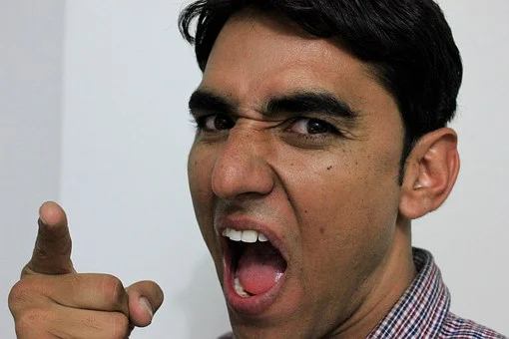
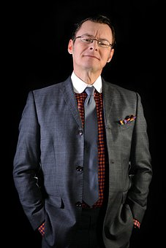
aggressive
quarrelsome
argumentative
arrogant
haughty

Slide 3

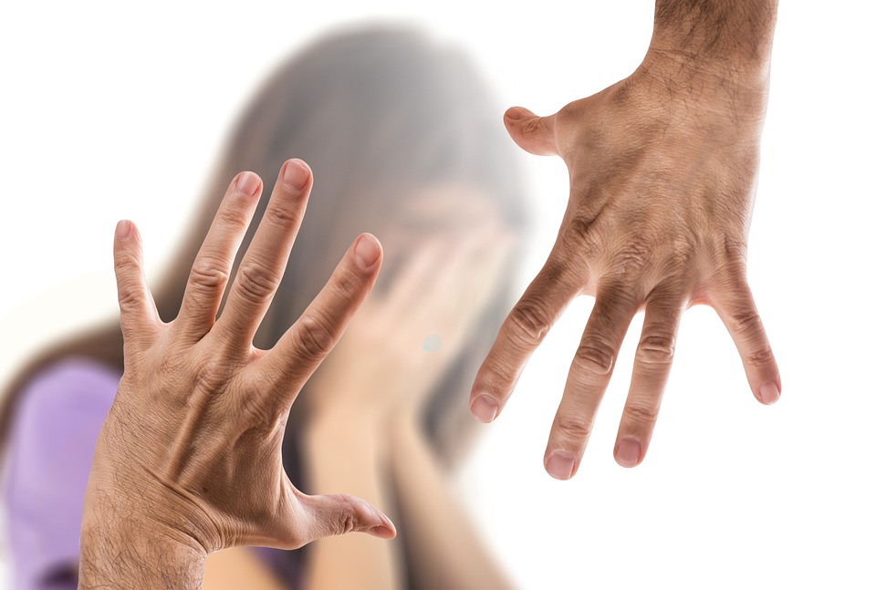
stubborn
ruthless
callous

Slide 4
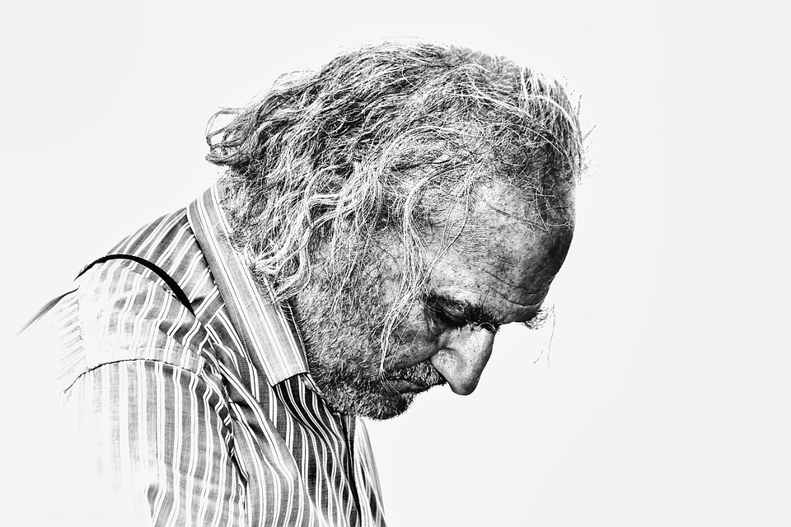
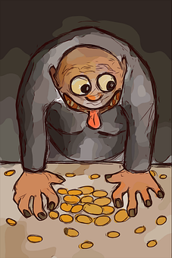
pessimist
greedy

Slide 5

fussy
cynical
skeptical

